Slide 1
ORACLE SQL Introduction
MTN.NIX.07
ORACLE DATABASE SECURITY BASICS
Siarhei Kandrashevich
Senior DB Developer

Slide 2
Objectives
Schemas, Users and other non-schema objects
Oracle Database Security
Managing Privileges
PL/SQL Dynamic SQL

Slide 3
Schemas, Users and other non-schema objects

Slide 4
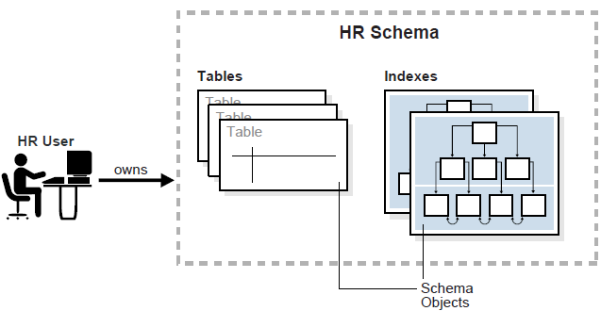
Oracle Database Schemas and Users
A database schema is a logical container for data structures, called schema objects. Examples of schema objects are tables and indexes. Schema objects are created and manipulated with SQL.
A database user (an account through which you can log in to an Oracle database) has a password and various database privileges. Each user owns a single schema, which has the same name as the user. The schema contains the data for the user owning the schema. For example, the HR user owns the HR schema, which contains schema objects such as the employees table.
In a production database,
the schema owner usually
represents a database
application rather than a
person.
Notes:
Within a schema, each schema object of a particular type has a unique name. For example, hr.employees refers to the table employees in the HR schema.

Slide 5
Oracle Non-Schema Objects
Non-schema objects are stored in the database and can be created and manipulated with SQL but are not contained in a schema.
Non-schema objects:
Contexts
Directories
Parameter files (PFILEs) and server parameter files (SPFILEs)
Profiles
Roles
Rollback segments
Tablespaces
Users
Oracle Database Security
Notes:
profile
A profile is collection of attributes that apply to a user. It enables a single point of reference for any of multiple users that share those exact attributes.
role
A set of privileges that can be granted to database users or to other roles.
context
A set of application-defined attributes that validates and secures an application. The SQL statement CREATE CONTEXT creates namespaces for contexts.
directory object
A database object that specifies an alias for a directory on the server file system where external binary file LOBs (BFILEs) and external table data are located. All directory objects are created in a single namespace and are not owned by an individual schema.

Slide 6
Privileges
A user privilege is the right to run a particular type of SQL statement, or the right to access an object that belongs to another user, run a PL/SQL package, and so on. The types of privileges are defined by Oracle Database.
System privileges. These privileges allow the grantee to perform standard administrator tasks in the database. Restrict them only to trusted users. A system privilege is the right to perform a particular action or to perform an action on any schema objects of a particular type.
Object privileges. Each type of object has privileges associated with it. For example:
Update a table
Select rows from another user's table
Execute a stored procedure of another user

Slide 7
Roles
Roles are created by users (usually administrators) to group together privileges or other roles. They are a way to facilitate the granting of multiple privileges or roles to users.
You grant privileges (directly or through roles) to users so they can accomplish tasks required for their jobs. Excessive granting of unnecessary privileges can compromise security.
A user can receive a privilege in two ways:
You can grant privileges to users explicitly. For example, you can explicitly grant to user SMITH the privilege to insert records into the employees table.
You can grant privileges to a role (a named group of privileges), and then grant the role to one or more users. For example, you can grant the privileges to select, insert, update, and delete records from the employees table to the role named CLERK, which in turn you can grant it to users SMITH and KING.
Notes:
Because roles allow for easier and better management of privileges, usually recommended grant privileges to roles and not to specific users.

Slide 8
Predefined User Accounts
Oracle Database includes a number of predefined user accounts. The three types of predefined accounts are:
Administrative accounts SYS schema is used to store database data dictionary SYSTEM is used to create additional tables and views that display administrative information, and internal tables and views used by various Oracle Database options and tools. SYSMAN is used to perform Oracle Enterprise Manager administration tasks. DBSNMP account used by management agent of Enterprise Manager to monitor and manage the database.
Sample schema accounts These accounts are used for examples in Oracle Database documentation and instructional materials. Examples are HR, SH, and OE. You must unlock these accounts and reset their passwords before using them.
Internal accounts These accounts are created so that individual Oracle Database features or components can have their own schemas. You must not delete internal accounts, and you must not attempt to log in with them.
Notes:
Both SYS and SYSTEM are DBA.
The DBA Role
A predefined DBA role is automatically created with every Oracle Database installation. This role contains most database system privileges. Therefore, the DBA role should be granted only to actual database administrators.

Slide 9
Oracle database security

Slide 10
Managing Users and Resources
To connect to the database, each user must specify a valid user name that has been previously defined to the database. An account must have been established for the user, with information about the user being stored in the data dictionary.
To create a database user (account) specify the following attributes:
User name
Authentication method
Default tablespace
Temporary tablespace
Other tablespaces and quotas
User profile
Optional

Slide 11
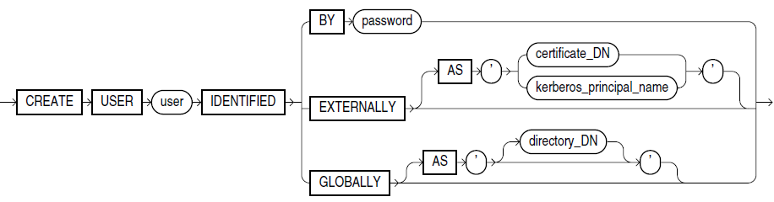
Create Database User
The CREATE USER statement is used to create a new user (you must have the CREATE USER system privilege to do this). Because it is a powerful privilege, a database administrator or security administrator is usually the only user who has the CREATE USER system privilege.

Slide 12
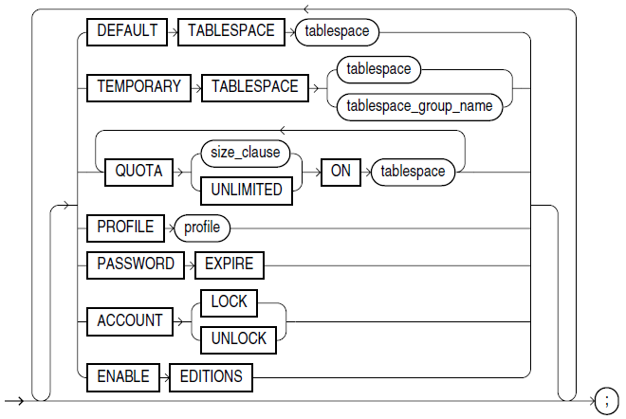
Create Database User (Additional Options)

Slide 13
Create Database User
CREATE USER test1
IDENTIFIED BY my_password
DEFAULT TABLESPACE users
QUOTA 1M ON users
TEMPORARY TABLESPACE temp
PROFILE default;
CONNECT test1/my_password
SELECT * FROM dual;
GRANT CREATE SESSION TO test1;
CONNECT test1/my_password
SELECT * FROM dual;
DROP USER test1;
Connect operation will fail (user has no privilege to connect to server)
(fix)
Connected
DUMMY
-----
X

Slide 14
Create Schema Objects as New User (test1)
CONNECT test1/my_password
SELECT count(*)
FROM all_objects;
CREATE TABLE all_obj AS
SELECT * FROM all_objects;
GRANT CREATE TABLE TO test1;
CREATE TABLE ALL_OBJ AS
SELECT * FROM all_objects;
ALTER USER test1 QUOTA 10M ON users;
CONNECT test1/my_password
CREATE TABLE all_obj AS SELECT * FROM all_objects;
SELECT count(*) FROM all_obj;
COUNT(*)
----------
56090
SQL Error: ORA-01031: insufficient privileges
(fix)
SQL Error: ORA-01536: space quota exceeded for tablespace 'USERS'
(fix)
COUNT(*)
----------
56091
Notes:
First result is 56090, but the second is 56091 (because table ALL_OBJ is object too).
After creating schema object, to drop user issue: DROP USER test1 CASCADE;

Slide 15
Predefined Roles: CONNECT, RESOURCE and DBA
RESOURCE
Provides the following system privileges:
CREATE CLUSTER
CREATE INDEXTYPE
CREATE OPERATOR
CREATE PROCEDURE
CREATE SEQUENCE
CREATE TABLE
CREATE TRIGGER
CREATE TYPE
CONNECT
Provides the following system privileges:
CREATE SESSION
DBA
Provides all system privileges WITH ADMIN OPTION.
Without:
CREATE MATERIALIZED VIEW
CREATE VIEW
CREATE SYNONYM
Grantee can grant this privilege further
Notes:
RESOURCE
Provides the following system privileges: CREATE CLUSTER, CREATE INDEXTYPE, CREATE OPERATOR, CREATE PROCEDURE, CREATE SEQUENCE, CREATE TABLE, CREATE TRIGGER, CREATE TYPE.
This role is provided for compatibility with previous releases of Oracle Database. You can determine the privileges encompassed by this role by querying the DBA_SYS_PRIVS data dictionary view.
Note: Oracle recommends that you design your own roles for database security rather than relying on this role. This role may not be created automatically by future releases of Oracle Database.
CONNECT
Provides the CREATE SESSION system privilege.
This role is provided for compatibility with previous releases of Oracle Database. You can determine the privileges encompassed by this role by querying the DBA_SYS_PRIVS data dictionary view.
Note: Oracle recommends that you design your own roles for database security rather than relying on this role. This role may not be created automatically by future releases of Oracle Database.

Slide 16
Managing PRIVILEGES

Slide 17
GRANT Statement
To grant a system privilege, one of the following conditions must be met:
You must have been granted the GRANT ANY PRIVILEGE system privilege.
You must have been granted the system privilege with the ADMIN OPTION.
To grant a role:
You must either have been granted the role with the ADMIN OPTION.
You must have been granted the GRANT ANY ROLE system privilege.
You must have created the role.
To grant an object privilege:
You must own the object
The owner of the object must have granted you the object privileges with the GRANT OPTION.
You must have been granted the GRANT ANY OBJECT PRIVILEGE system privilege.
Notes:
To grant a system privilege, one of the following conditions must be met:
You must have been granted the GRANT ANY PRIVILEGE system privilege. In this case, if you grant the system privilege to a role, then a user to whom the role has been granted does not have the privilege unless the role is enabled in user's session.
You must have been granted the system privilege with the ADMIN OPTION. In this case, if you grant the system privilege to a role, then a user to whom the role has been granted has the privilege regardless whether the role is enabled in the user's session.
To grant a role, you must either have been granted the role with the ADMIN OPTION or have been granted the GRANT ANY ROLE system privilege, or you must have created the role.
To grant an object privilege, you must own the object, or the owner of the object must have granted you the object privileges with the GRANT OPTION, or you must have been granted the GRANT ANY OBJECT PRIVILEGE system privilege. If you have the GRANT ANY OBJECT PRIVILEGE, then you can grant the object privilege only if the object owner could have granted the same object privilege. In this case, the GRANTOR column of the DBA_TAB_PRIVS view displays the object owner rather than the user who issued the GRANT statement.

Slide 18

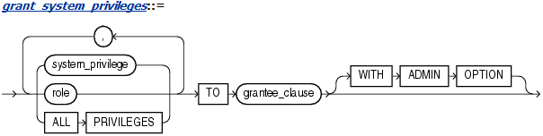
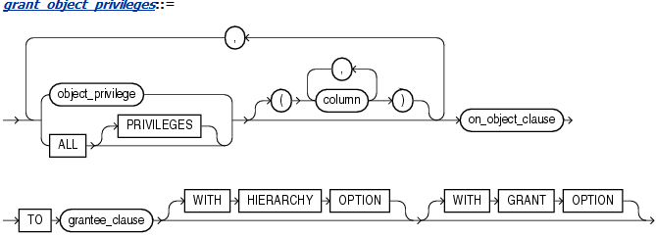
GRANT Syntax

Slide 19
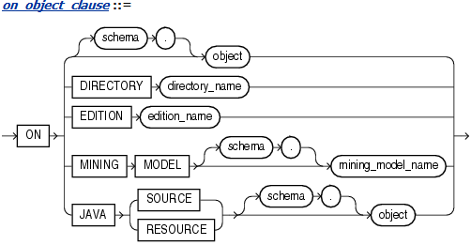
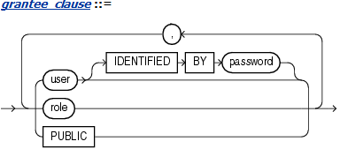
GRANT Syntax [2]

Slide 20
System Privileges
SEQUENCES
CREATE SEQUENCE
CREATE ANY SEQUENCE
ALTER ANY SEQUENCE
DROP ANY SEQUENCE
SELECT ANY SEQUENCE
TABLES
CREATE TABLE
CREATE ANY TABLE
ALTER ANY TABLE
BACKUP ANY TABLE
DELETE ANY TABLE
DROP ANY TABLE
INSERT ANY TABLE
LOCK ANY TABLE
SELECT ANY TABLE
FLASHBACK ANY TABLE
UPDATE ANY TABLE
ROLES
CREATE ROLE
ALTER ANY ROLE
DROP ANY ROLE
GRANT ANY ROLE
VIEWS
CREATE VIEW
CREATE ANY VIEW
DROP ANY VIEW
UNDER ANY VIEW
FLASHBACK ANY TABLE
MERGE ANY VIEW
Notes:
Reduced.
The full list can be found in http://docs.oracle.com/cd/E11882_01/server.112/e26088/statements_9013.htm#i2155015

Slide 21
Object Privileges
TABLES
ALTER
DELETE
DEBUG
INDEX
INSERT
REFERENCES
SELECT
UPDATE
VIEWS
DEBUG
DELETE
INSERT
MERGE
REFERENCES
SELECT
UNDER
UPDATE
SEQUENCES
ALTER
SELECT

Slide 22
GRANT Example 1: System Privileges
CREATE USER TEST1
IDENTIFIED BY my_password
DEFAULT TABLESPACE users
TEMPORARY TABLESPACE temp;
GRANT CONNECT, RESOURCE TO TEST1;
CREATE ROLE DW_MANAGER;
GRANT
CREATE MATERIALIZED VIEW,
QUERY REWRITE,
GLOBAL QUERY REWRITE
TO DW_MANAGER
WITH ADMIN OPTION;
GRANT DW_MANAGER TO TEST1
WITH ADMIN OPTION;
DROP ROLE DW_MANAGER;
DROP USER TEST1 CASCADE;
CONNECT test1/my_password
CREATE
MATERIALIZED VIEW MV_TEST AS
SELECT * FROM DUAL;
DROP MATERIALIZED VIEW MV_TEST;
Notes:
CREATE MATERIALIZED VIEW
Create a materialized view in the grantee's schema.
------------------------------------------------------
select *
from dba_sys_privs
where grantee = 'DW_MANAGER';

Slide 23
GRANT Example 2: System Privileges
CREATE USER TEST1
IDENTIFIED BY my_password
DEFAULT TABLESPACE users
TEMPORARY TABLESPACE temp;
GRANT CONNECT, RESOURCE TO TEST1;
CREATE ROLE DW_MANAGER;
GRANT CREATE ANY MATERIALIZED VIEW,
ALTER ANY MATERIALIZED VIEW,
DROP ANY MATERIALIZED VIEW,
QUERY REWRITE,
GLOBAL QUERY REWRITE
TO DW_MANAGER
WITH ADMIN OPTION;
GRANT DW_MANAGER TO TEST1
WITH ADMIN OPTION;
DROP ROLE DW_MANAGER;
DROP USER TEST1 CASCADE;
CONNECT test1/my_password
CREATE
MATERIALIZED VIEW SH.MV_TEST AS
SELECT * FROM DUAL;
DROP
MATERIALIZED VIEW SH.MV_TEST;
Notes:
Create MView in SH schema.
CREATE ANY MATERIALIZED VIEW
Create materialized views in any schema.
ALTER ANY MATERIALIZED VIEW
Alter materialized views in any schema.
DROP ANY MATERIALIZED VIEW
Drop materialized views in any schema.
------------------------------------------------------
select *
from dba_sys_privs
where grantee = 'DW_MANAGER';

Slide 24
GRANT Examples: Object Privileges
GRANT SELECT ON SH.SALES TO WAREHOUSE_USER_ROLE;
GRANT WAREHOUSE_USER_ROLE TO DW_MANAGER;
GRANT ALL ON BONUSES TO HR WITH GRANT OPTION;
GRANT SELECT, UPDATE ON EMP_VIEW TO PUBLIC;
GRANT SELECT ON OE.CUSTOMERS_SEQ TO HR;
GRANT
REFERENCES (EMPLOYEE_ID),
UPDATE (EMPLOYEE_ID, SALARY, COMMISSION_PCT)
ON HR.EMPLOYEES
TO OE;
CREATE TABLE DEPENDENT (
DEPENDNO NUMBER,
DEPENDNAME VARCHAR2(10),
EMPLOYEE NUMBER
CONSTRAINT IN_EMP REFERENCES HR.EMPLOYEES(EMPLOYEE_ID)
);
BONUSES and EMP_VIEW are in current schema
FK references to table in different schema
Notes:
GRANT SELECT ON SH.SALES TO WAREHOUSE_USER_ROLE;
GRANT WAREHOUSE_USER_ROLE TO DW_MANAGER;
GRANT ALL ON BONUSES TO HR WITH GRANT OPTION;
GRANT SELECT, UPDATE ON EMP_VIEW TO PUBLIC;
GRANT SELECT ON oe.customers_seq TO hr;
GRANT REFERENCES (EMPLOYEE_ID),
UPDATE (EMPLOYEE_ID, SALARY, COMMISSION_PCT)
ON HR.EMPLOYEES
TO OE;
CREATE TABLE DEPENDENT
(
DEPENDNO NUMBER,
DEPENDNAME VARCHAR2(10),
EMPLOYEE NUMBER
CONSTRAINT IN_EMP REFERENCES HR.EMPLOYEES(EMPLOYEE_ID)
);

Slide 25

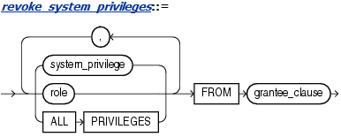
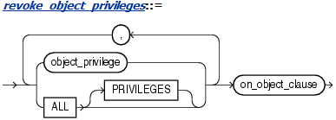

REVOKE Syntax [1]
Notes:
Revoke
Use the REVOKE statement to:
Revoke system privileges from users and roles
Revoke roles from users and roles
Revoke object privileges for a particular object from users and roles
Prerequisites
To revoke a system privilege, you must have been granted the privilege with the ADMIN OPTION.
You can revoke any privilege if you have the GRANT ANY PRIVILEGE system privilege.
To revoke a role, you must have been granted the role with the ADMIN OPTION. You can revoke any role if you have the GRANT ANY ROLE system privilege.
To revoke an object privilege, you must previously have granted the object privilege to the user and role or you must have the GRANT ANY OBJECT PRIVILEGE system privilege. In the latter case, you can revoke any object privilege that was granted by the object owner or on behalf of the owner by a user with the GRANT ANY OBJECT PRIVILEGE. However, you cannot revoke an object privilege that was granted by way of a WITH GRANT OPTION grant.
The REVOKE statement can revoke only privileges and roles that were previously granted directly with a GRANT statement.
You cannot use this statement to revoke:
Privileges or roles not granted to the revokee
Roles or object privileges granted through the operating system
Privileges or roles granted to the revokee through roles

Slide 26
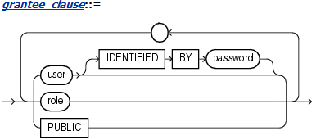
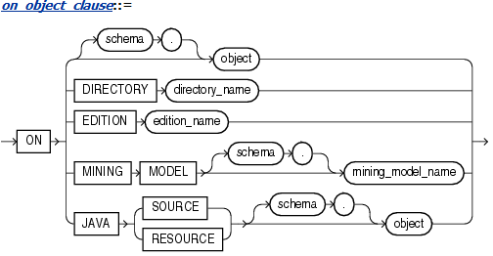
REVOKE Syntax [2]

Slide 27
REVOKE Examples
REVOKE WAREHOUSE_USER_ROLE FROM DW_MANAGER;
GRANT ALL ON ORDERS TO HR;
REVOKE DELETE ON ORDERS FROM HR;
REVOKE ALL ON ORDERS FROM HR;
GRANT SELECT, UPDATE ON EMP_DETAILS_VIEW TO PUBLIC;
REVOKE UPDATE ON EMP_DETAILS_VIEW FROM PUBLIC;
GRANT SELECT ON HR.DEPARTMENTS_SEQ TO OE;
REVOKE SELECT ON HR.DEPARTMENTS_SEQ FROM OE;
Connected as
OE user
Notes:
Revoke role from current user example.
CONN SYSTEM
CREATE USER TEST1
IDENTIFIED BY my_password
DEFAULT TABLESPACE users
TEMPORARY TABLESPACE temp;
GRANT CONNECT, RESOURCE TO TEST1;
CREATE ROLE DW_MANAGER;
GRANT
CREATE ANY MATERIALIZED VIEW,
ALTER ANY MATERIALIZED VIEW,
DROP ANY MATERIALIZED VIEW,
QUERY REWRITE,
GLOBAL QUERY REWRITE
TO DW_MANAGER
WITH ADMIN OPTION;
GRANT DW_MANAGER
TO TEST1 WITH ADMIN OPTION;
/*
The first execution – everything will be Ok (revoke done, but SH.MV_TEST created successfully and dropped).
The second execution:
REVOKE gives ORA-01919: role 'DW_MANAGER' does not exist
CREATE and DROP give ORA-01031: insufficient privileges
*/
CONNECT test1/my_password
REVOKE DW_MANAGER FROM TEST1;
CREATE MATERIALIZED VIEW SH.MV_TEST AS
SELECT * FROM DUAL;
DROP MATERIALIZED VIEW SH.MV_TEST;
CONN SYSTEM
DROP ROLE DW_MANAGER;
DROP USER TEST1 CASCADE;

Slide 28
REVOKE Examples: Cascade Constraints
CONNECT HR
GRANT REFERENCES, UPDATE ON EMPLOYEES
TO TEST1;
CONNECT TEST1/my_password
CREATE TABLE DEPENDENT (
DEPENDNO NUMBER,
DEPENDNAME VARCHAR2(10),
EMPLOYEE NUMBER
CONSTRAINT FK_EMP REFERENCES HR.EMPLOYEES(EMPLOYEE_ID)
);
CONNECT HR
REVOKE REFERENCES ON EMPLOYEES
FROM TEST1;
CONNECT HR
REVOKE REFERENCES ON EMPLOYEES
FROM TEST1 CASCADE CONSTRAINTS;
ORA-01981: CASCADE CONSTRAINTS must be specified to perform this revoke
Constraint FK_EMP will be dropped
Notes:
GRANT REFERENCES, UPDATE ON HR.EMPLOYEES TO OE;
CREATE TABLE DEPENDENT
(
DEPENDNO NUMBER,
DEPENDNAME VARCHAR2(10),
EMPLOYEE NUMBER
CONSTRAINT IN_EMP REFERENCES HR.EMPLOYEES(EMPLOYEE_ID)
);
REVOKE REFERENCES
ON HR.EMPLOYEES
FROM OE
CASCADE CONSTRAINTS;

Slide 29
PL/SQL Dynamic SQL

Slide 30
PL/SQL Dynamic SQL
PL/SQL provides two ways to write dynamic SQL:
Native dynamic SQL, a PL/SQL language (that is, native) feature for building and running dynamic SQL statements
DBMS_SQL package, an API for building, running, and describing dynamic SQL statements
When You Need Dynamic SQL
In PL/SQL, you need dynamic SQL to run:
SQL whose text is unknown at compile time
For example, a SELECT statement that includes an identifier that is unknown at compile time (such as a table name) or a WHERE clause in which the number of subclauses is unknown at compile time.
SQL that is not supported as static SQL

Slide 31
EXECUTE IMMEDIATE Statement
If the dynamic SQL statement includes placeholders for bind variables, each placeholder must have a corresponding bind variable in the appropriate clause of the EXECUTE IMMEDIATE statement, as follows:
If the dynamic SQL statement is a SELECT statement that can return at most one row, put out-bind variables (defines) in the INTO clause and in-bind variables in the USING clause.
If the dynamic SQL statement is a SELECT statement that can return multiple rows, put out-bind variables (defines) in the BULK COLLECT INTO clause and in-bind variables in the USING clause.
If the dynamic SQL statement is a DML statement without a RETURNING INTO clause, other than SELECT, put all bind variables in the USING clause.
If the dynamic SQL statement is a DML statement with a RETURNING INTO clause, put in-bind variables in theUSING clause and out-bind variables in the RETURNING INTO clause.
If the dynamic SQL statement is an anonymous PL/SQL block or a CALL statement, put all bind variables in theUSING clause.

Slide 32
EXECUTE IMMEDIATE Statement: Example
CREATE OR REPLACE PROCEDURE p (x BOOLEAN) AUTHID DEFINER AS
BEGIN
IF x THEN
DBMS_OUTPUT.PUT_LINE('x is true');
END IF;
END;
/
DECLARE
dyn_stmt VARCHAR2(200);
b BOOLEAN := TRUE;
BEGIN
dyn_stmt := 'BEGIN p(:x); END;';
EXECUTE IMMEDIATE dyn_stmt USING b;
END;
/

Slide 33
EXECUTE IMMEDIATE Statement: Example 2
CREATE OR REPLACE PACKAGE pkg AUTHID DEFINER AS
TYPE foursome IS VARRAY(4) OF VARCHAR2(5);
PROCEDURE print_foursome (x foursome);
END pkg;
/
CREATE OR REPLACE PACKAGE BODY pkg AS
PROCEDURE print_foursome (x foursome) IS
BEGIN
IF x.COUNT = 0 THEN
DBMS_OUTPUT.PUT_LINE('Empty');
ELSE
FOR i IN x.FIRST .. x.LAST LOOP
DBMS_OUTPUT.PUT_LINE(x(i));
END LOOP;
END IF;
END;
END pkg;

Slide 34
EXECUTE IMMEDIATE Statement: Example 3
DECLARE
directions pkg.foursome;
dyn_stmt VARCHAR2(3000);
BEGIN
directions := pkg.foursome('north', 'south', 'east', 'west');
dyn_stmt := 'BEGIN pkg.print_foursome(:x); END;';
EXECUTE IMMEDIATE dyn_stmt USING directions;
END;
/

Slide 35
ORACLE SQL INTODUCTION
MTN.NIX.07
Questions & Answers
Siarhei Kandrashevich
Senior DB Developer

